Slide 1
Restaurant Recommendation System
Zhuoyan Liu, Mahi Shah, Rishabh Setty,
Siming Su

Slide 2
Our Project Objective
The objective of project is to develop and implement a sophisticated analytical framework capable of generating a precisely tailored list of restaurant recommendations.
By analyzing user profiles, ratings and restaurant characteristics, we strive to deliver a top-n list of restaurants tailored to individual tastes and needs.

Slide 3
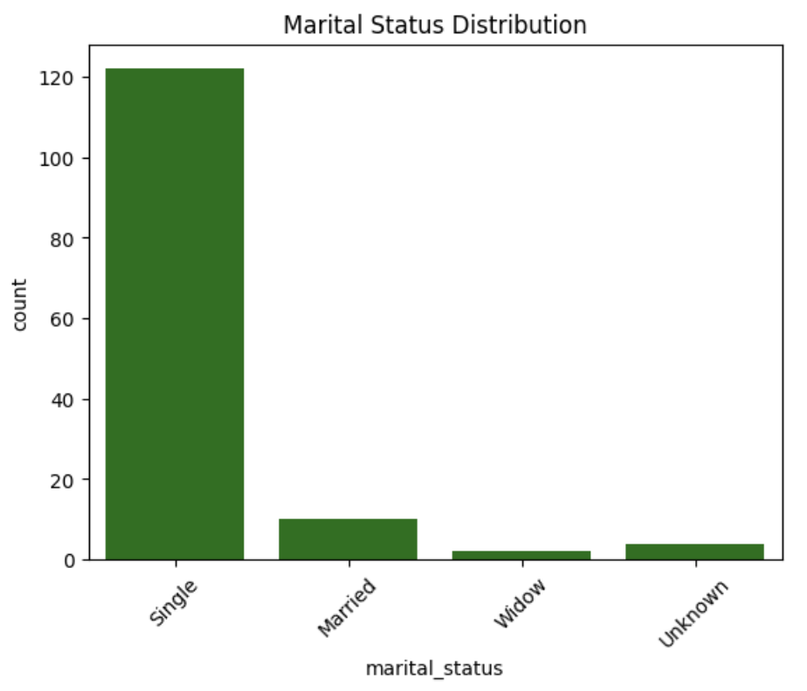
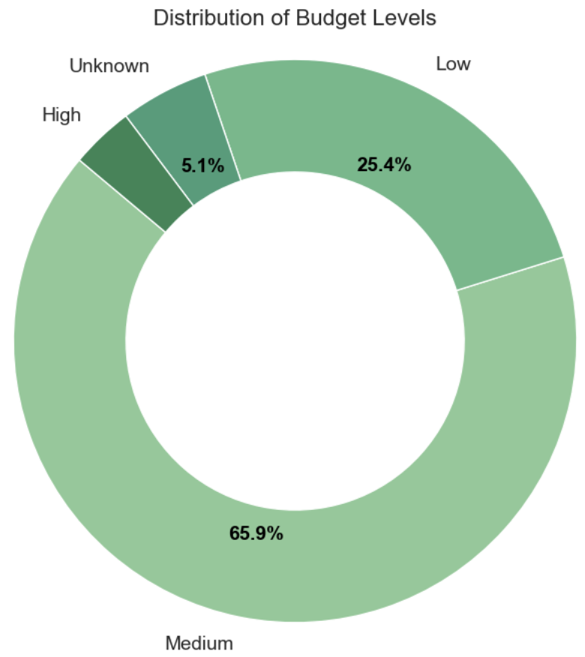
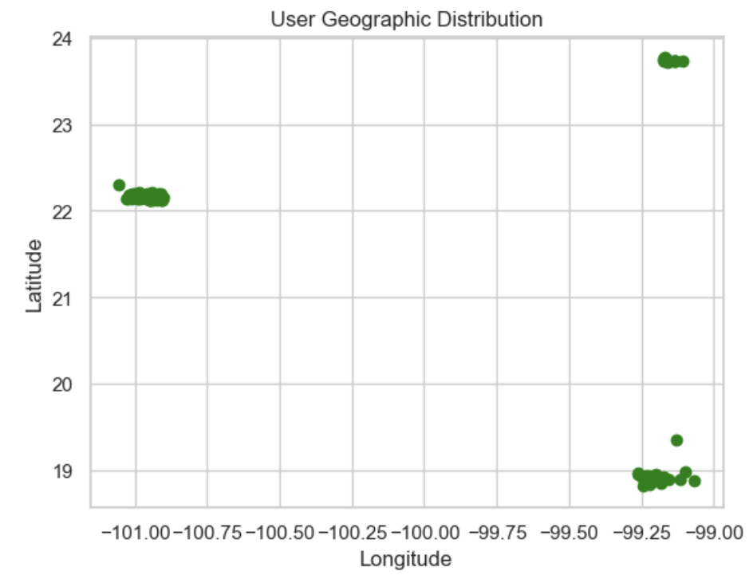
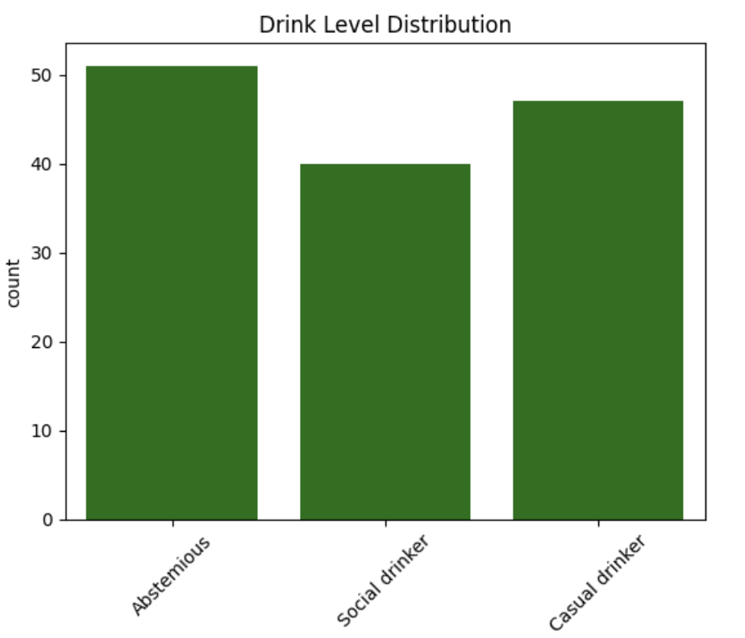
Dataset Overview
9 files: User Profile, Restaurant Description, Ratings
User Profile:
Demographic
Height, Weight, Color Age
Preferences
Drink Level, Cuisine, Ambience
Descriptors
Location, Family, Kids

Slide 4
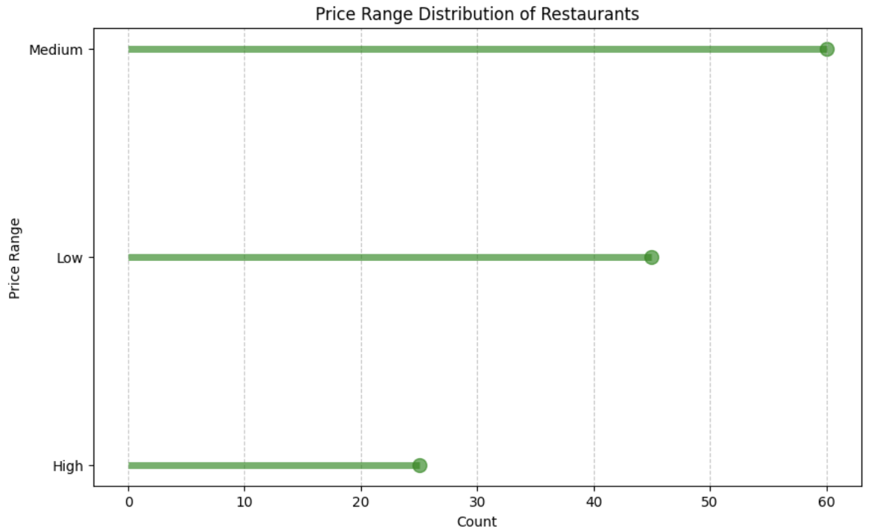
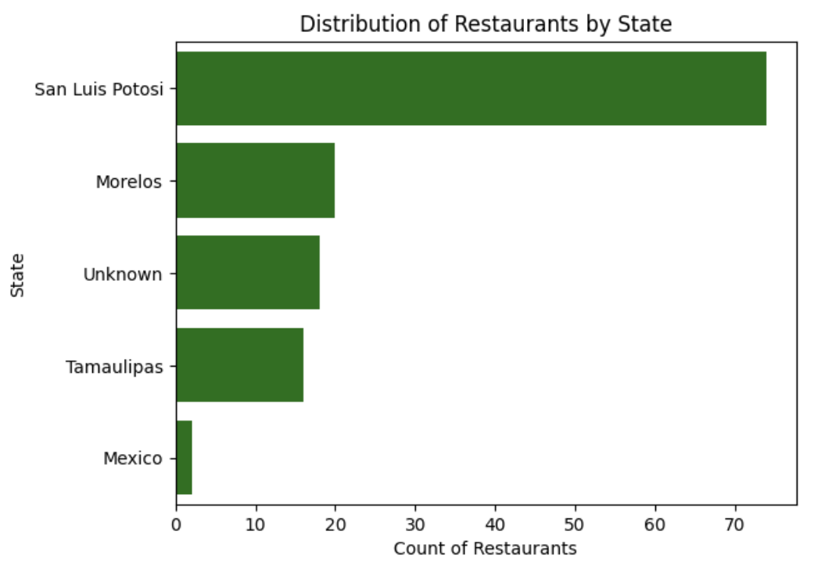
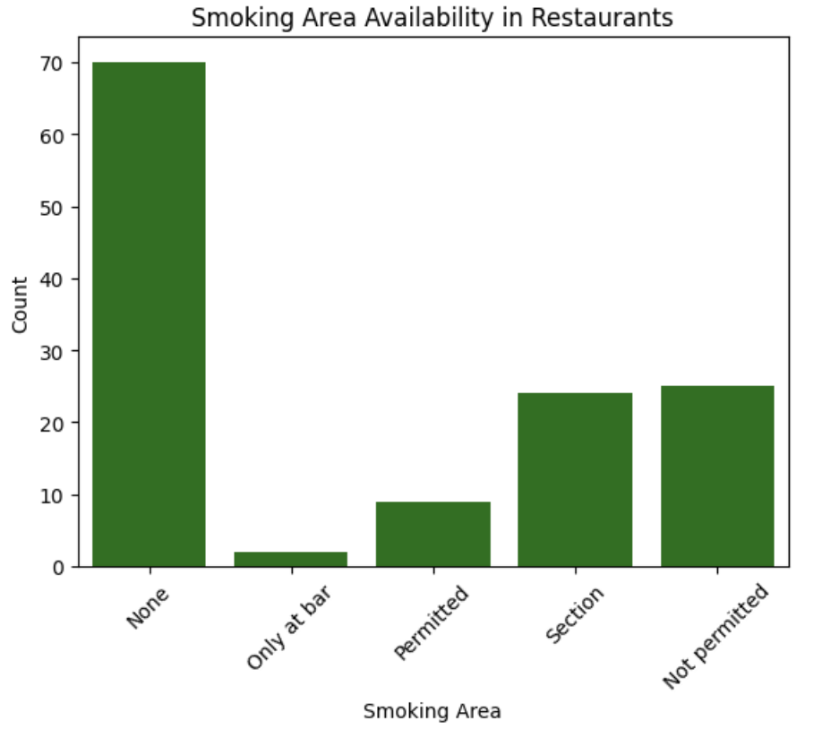
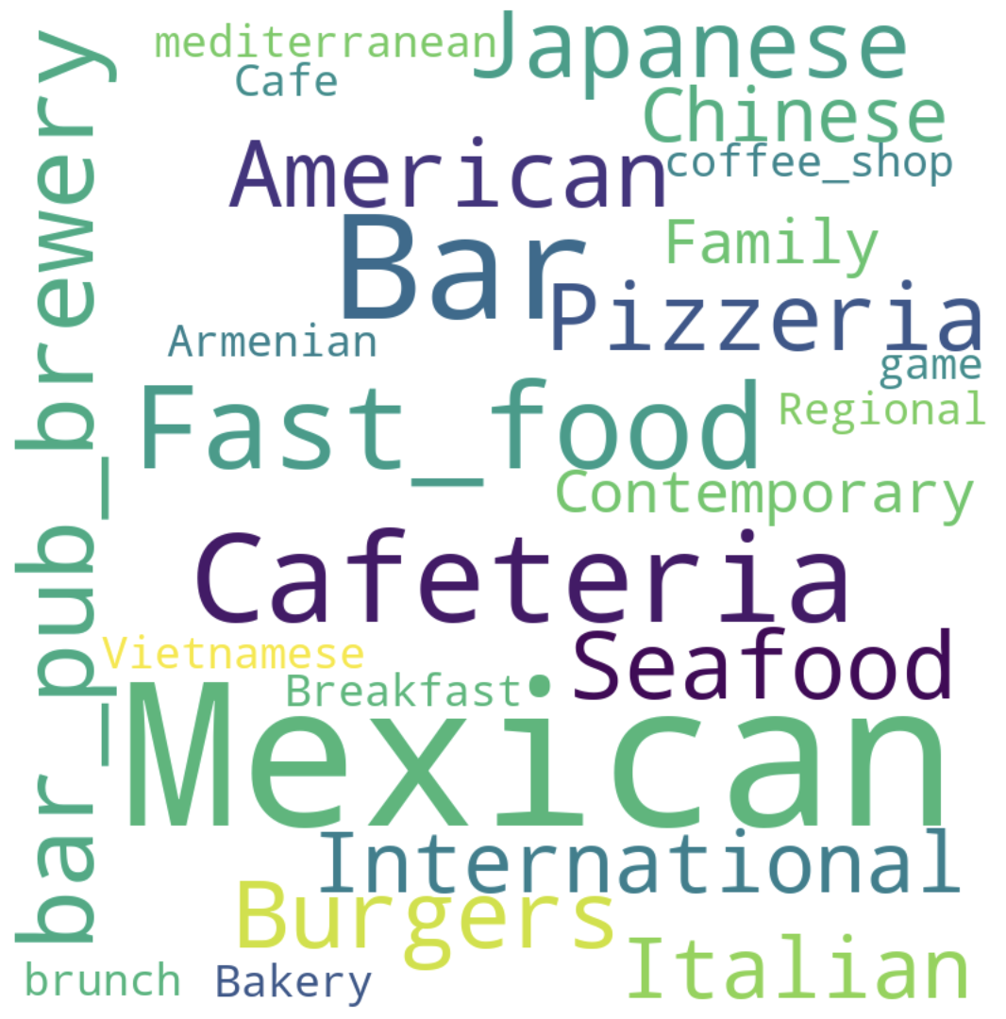
Dataset Overview
9 files: User Profile, Restaurant Description, Ratings
Restaurant Description:
Amenities
Alcohol, Smoking Area
Descriptors
Ambience, Dress Code, Cuisines, Sitting Area, Price Range

Slide 5
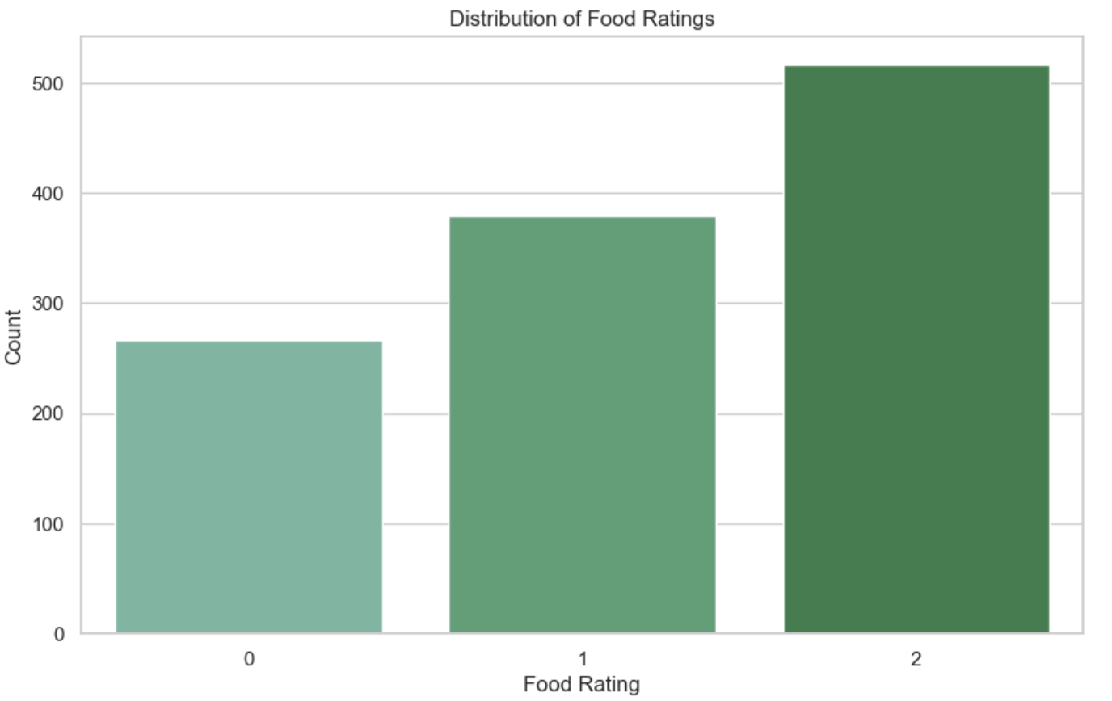
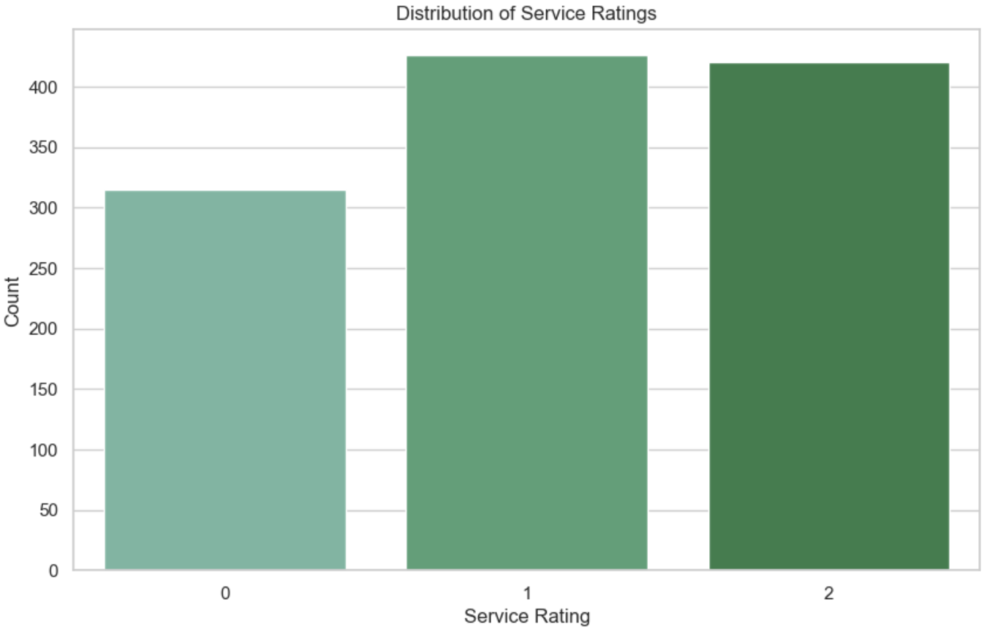
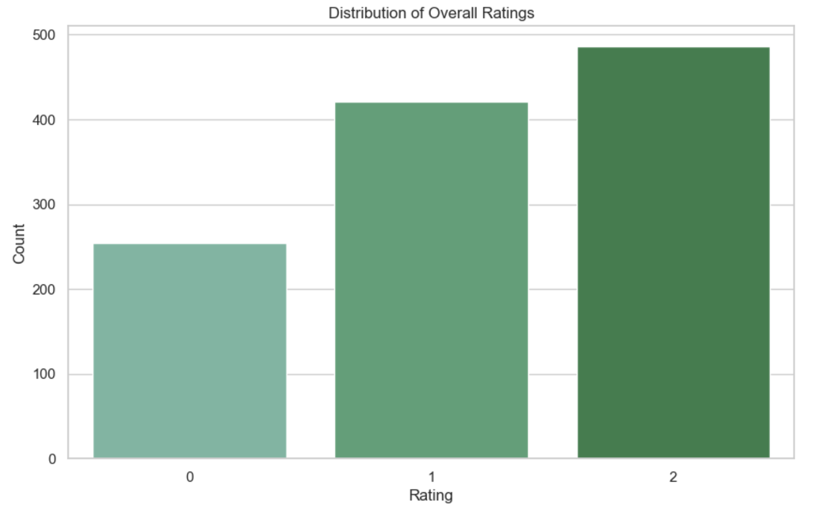
Dataset Overview
9 files: User Profile, Restaurant Description, Ratings
Ratings:
Overall Rating
Food Rating
Service Rating

Slide 6
EDA & Data Cleaning
Consistency
Drop NaN Values, Duplicate rows & columns, Bin Categorical Variables
130 restaurants
+1 was added to each rating to preserve ordinality
16 attributes
Bias/
Fairness
Drop protected attributes like height, color, weight & religion
138 user profiles
18 attributes
3 types of ratings

Slide 7
Our Model Structure
A
Clustering
Initial Dataset
B
Graph Mining
EDA
&
Data Cleaning
C
Recommender System

Slide 8
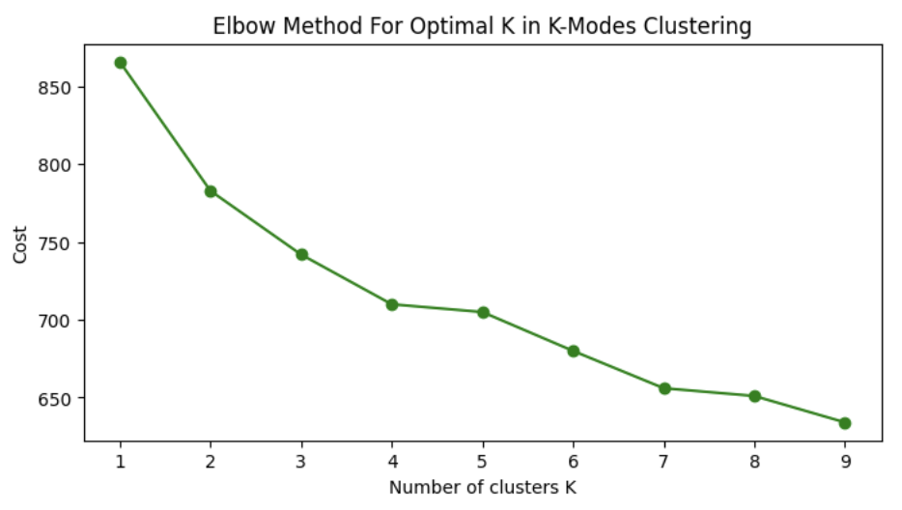
Clustering Process [Restaurants]
Method 01 |  | KModes | It seems to not have elbow point
Method 02 |  | One Hot + DBSCAN | Gives 100+ clusters
Method 03 |  | One Hot + GMM | Gives the best 3 interpretable clusters

Slide 9
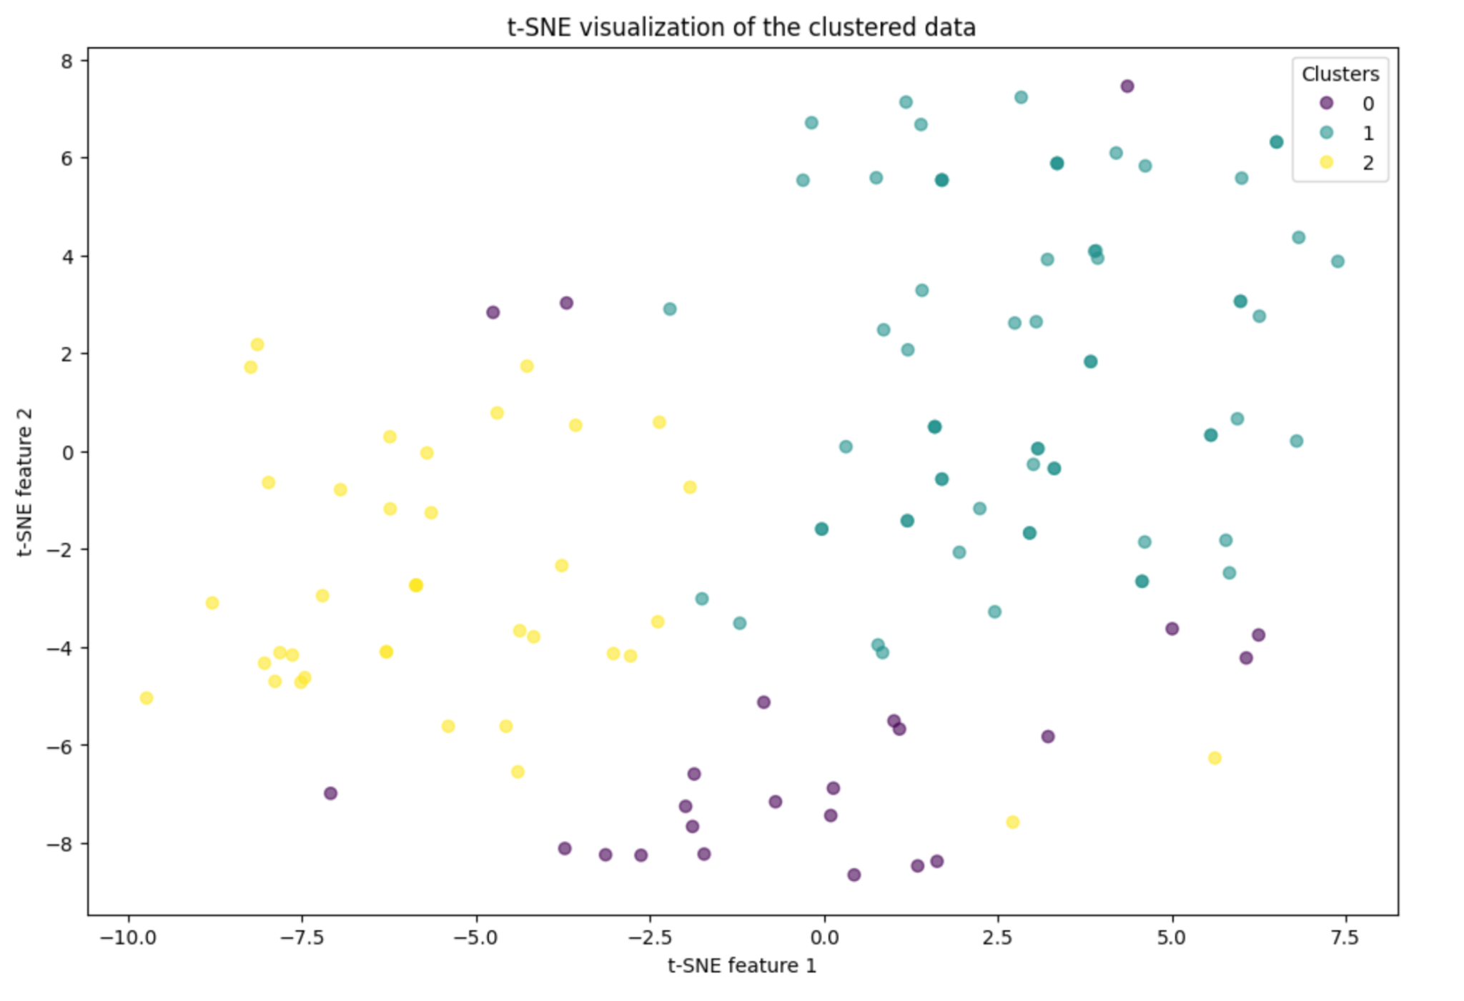
Visualization using TSNE
Features we used:
state, alcohol, smoking_area, dress_code, accessibility, price, ambience, franchise, area, cuisine
Even though the clusters do not separate far enough, but we still see 3 clusters via visualization.

Slide 10
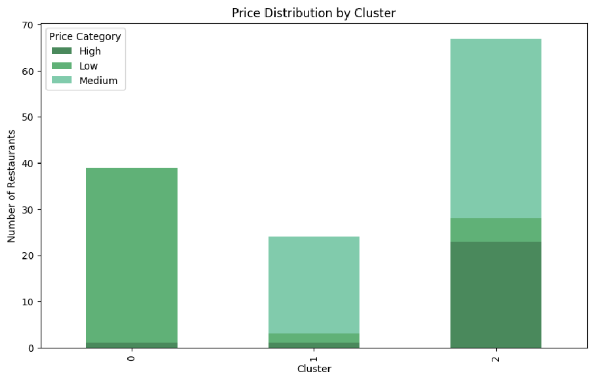
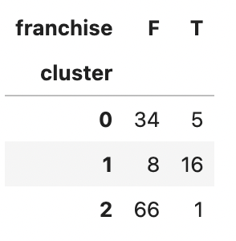
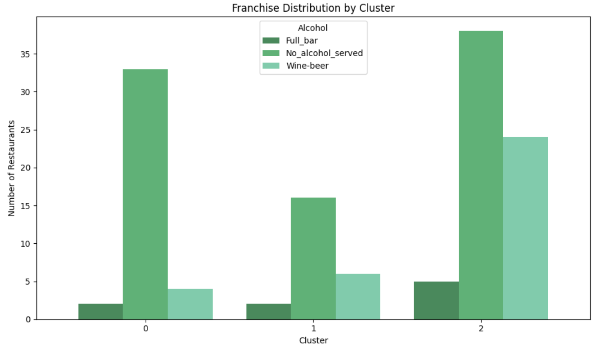
Interpretation of Clusters
Cluster 0: “Lower-end” Restaurant
Cluster 1: “Mid-range” Restaurant
Cluster 2: “Mid to Higher-end” Restaurant

Slide 11
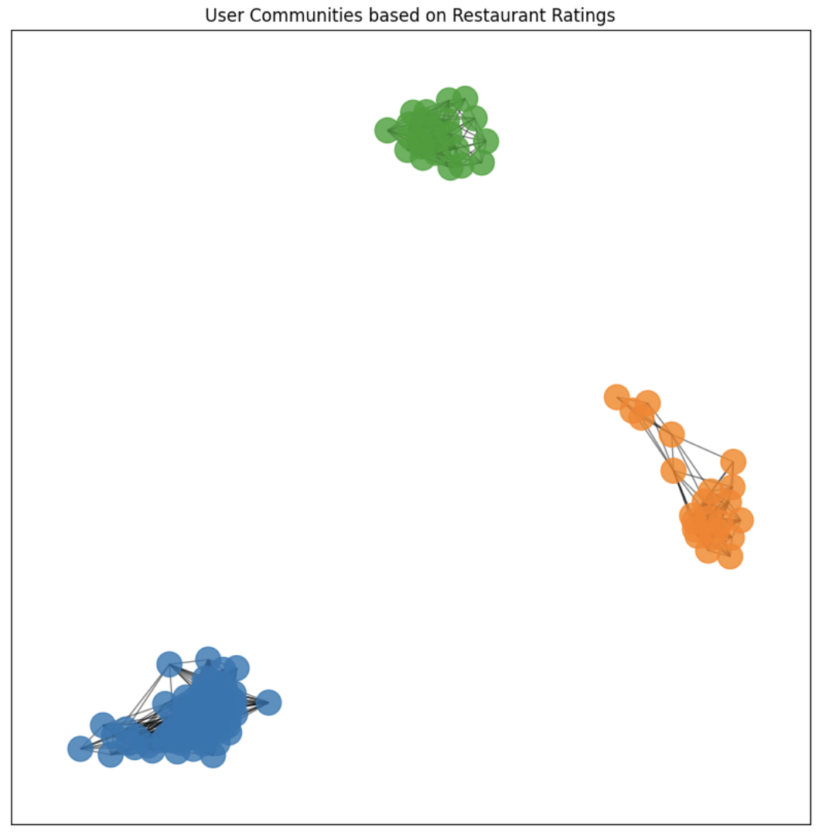
Graph Mining (Spectral clustering) [users]
This graph is made by adjacency matrix which weight is defined by “same Restaurant rating”
Key takeaways:
3 apparent User Clusters
Customers only try their local Restaurants
Possible insights for recommendations

Slide 12
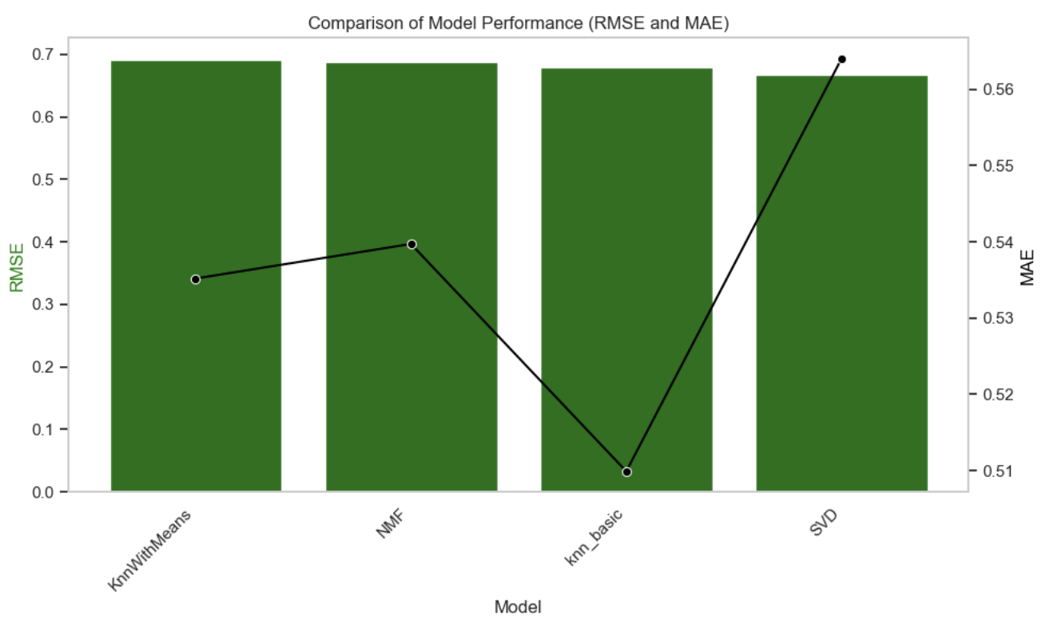
Recommendation Engines
Collaborative Filtering
Method 01 |  | KNNBasic | Item Based, K = 20
Method 02 |  | KNNMeans | User Based, K = 10
Method 03 |  | SVD | Learning Rate = 0.07 # Factors = 50
Method 04 |  | NMF | Epochs = 50 # Factors = 150

Slide 13
Recommendation Engines
SVD
1
Singular Value Decomposition
User Based CF
2
Collaborative Filtering
Network Recommendation
3
Based on Users Community

Slide 14


Recommender System
SVD
Input
User
Based
Predicted Result
Combiner
User in Network?
Network Based
Popularity Based

Slide 15
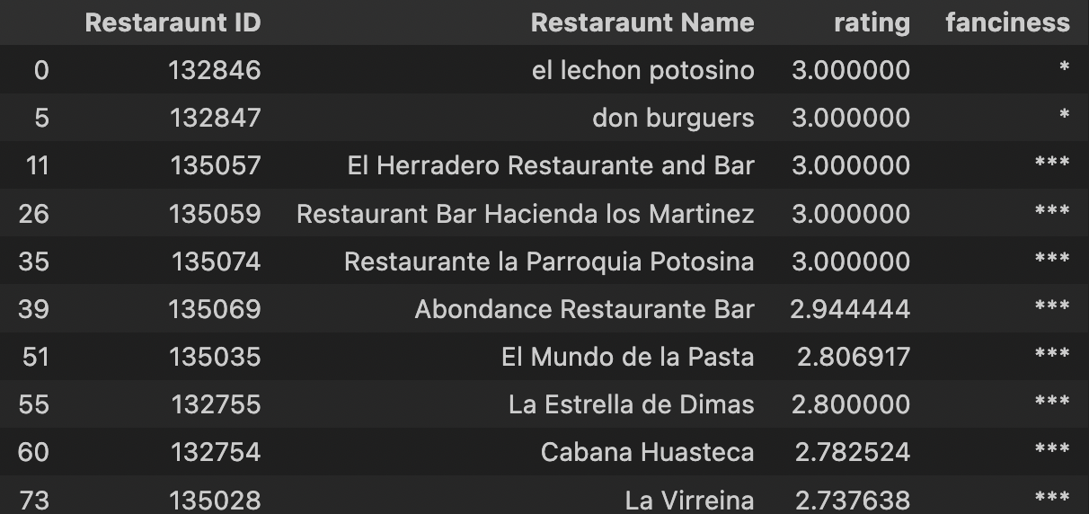
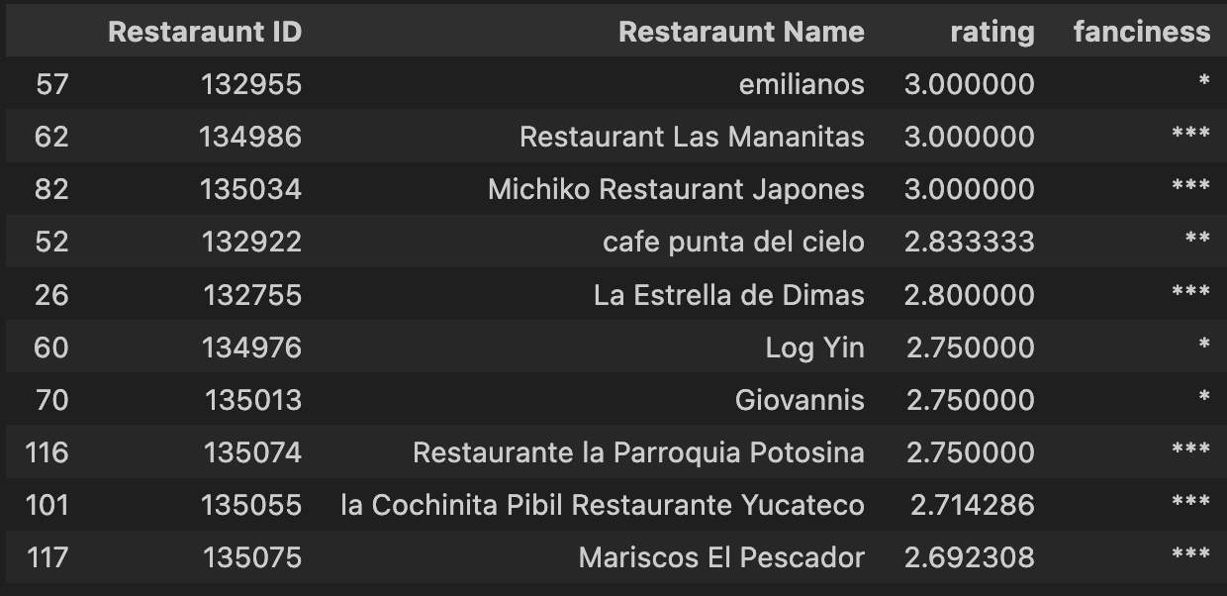
Recommendation Examples
Top 10 Recommendations for User “U1006”: Top 10 Recommendations for Top 10 Recommendations for User “U1006”: Top 10 Recommendations for NNonUsernon“U1006”:
NNonUsernon“U1006”:
Top 10 Recommendations for Cold Starter:

Slide 16
Challenges and Solutions
Missing Values - Data was missing from a user profiles & restaurant description probably due to hesitance to share or unavailability
Small Dataset - The user data was not very varied in terms of types of users and centralised to a small geography
Saturn
Saturn has several rings
Venus
Venus is a very hot planet

Slide 17
Future Work
Additional data sources, such as social media preferences and real-time location data.
Investigating more sophisticated machine learning models, like neural networks, could also offer improvements in predictive accuracy and personalization.
Impact of temporal factors, such as seasonality on consumer preferences.
Employ a more flexible recommendation system that can take the type of rating as in input to generate recommendations accordingly.

